Slide 1

Notes:
Movistar TV is the Digital Video Platform offered by Telefónica in South America ( Argentina, brazil, Chile, and Peru ) and Spain.

Slide 2

Almudena Vivanco
(@MrsDaehin)
From .net developer to tester. 10 years of experience as performance engineer. Now working in Telefónica I+D as “Performance Jedi”.
Active member of the web performance community in Barcelona.
Gaming, Music and Maths are my passion
My motto: Games don’t cause violence, Lag does!
Who are we?

Slide 3
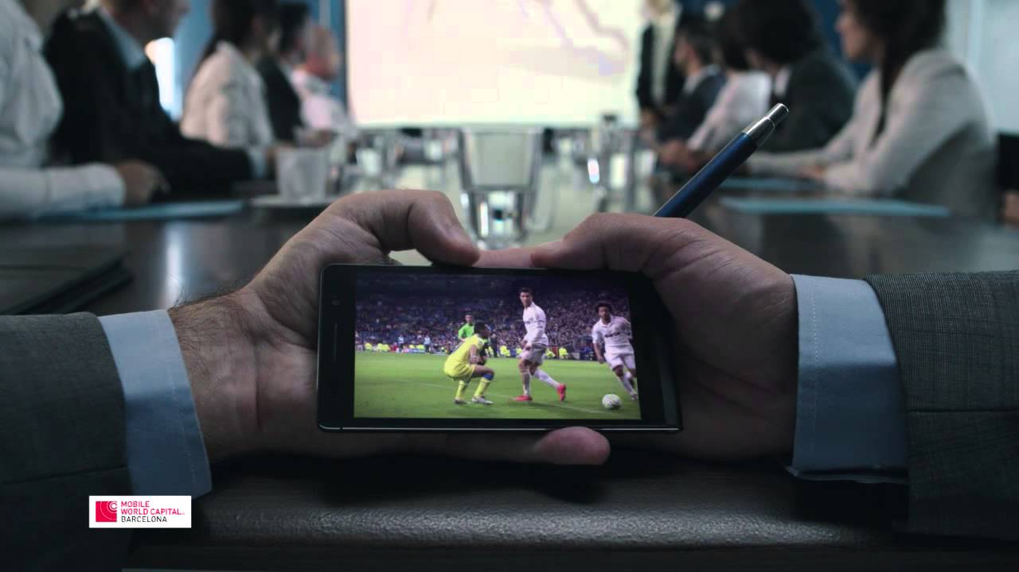
Guide to survive a World Wide Event
Notes:
movistar TV is the video Solution offered by Telefonica. 2 years ago a television on mobile devices was offered. GO TV is a free service offered to the Movistar TV users.
movistar TV offers both OTT and IPTV. We are gonna talk basically on OTT
Over-the-top content (OTT) refers to delivery of audio, video, and other media over the Internet without a multiple-system operator being involved in the control or distribution of the content. The provider may be aware of the contents of the Internet Protocol packets but is not responsible for, nor able to control, the viewing abilities, copyrights, and/or other redistribution of the content. This is in contrast to purchase or rental of video or audio content from an Internet service provider (ISP), such as pay television video on demand or an IPTV video service, like AT&T U-Verse. OTT in particular refers to content that arrives from a third party, such as Dramatize, DramaFever, Crackle, HBO, Hulu,myTV, NetD, Netflix, NowTV, RPI TV, WhereverTV, or WWE Network, and is delivered to an end user device, leaving the ISP responsible only for transporting IP packets.
a team of 200 people with the goal of making of telefonica a video company
Movistar TV is not just Mobile TV but we will talk just about mobile what we call GO TV
2 years ago GO TV went live all the bets into a quality mobile television considering the growth of mobile devices.

Slide 4

Build the best Video Platform to help Telefonica to become a Video Company
The Challenge
Notes:
Build the best Video Platform to help Telefonica to become a Video ComBuild the best Video Platform to help Telefonica to become a Video Company
Build the best Video Platform to help Telefonica to become a Video Company
pany

Slide 5
The golden rule
PASSION - If it was OK, they will be back
DON’T MISS THE TARGET – The audience go away
WILL START WITHOUT YOU - The soccer game will start at the date/time
The Golden Rule
Notes:
One Shoot

Slide 6
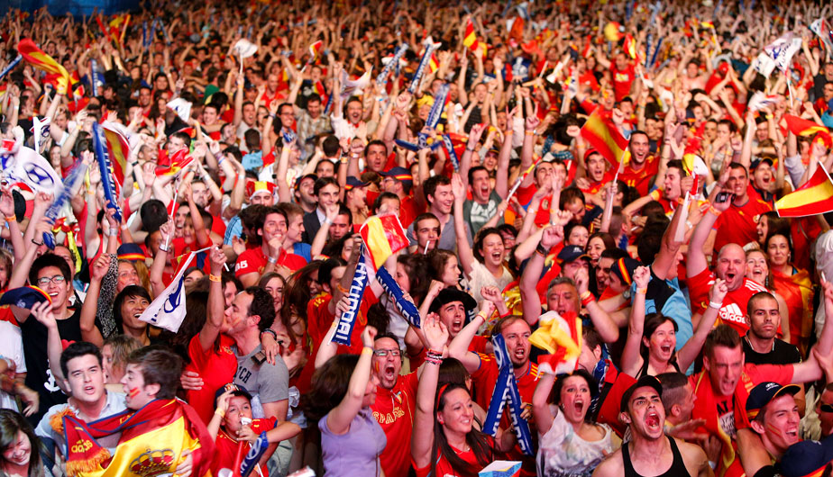
The Users
Notes:
Users that peak Load joining in 5 minutes before the match
What we feared the most a Brazil - Spain - Argentina Match :D

Slide 7
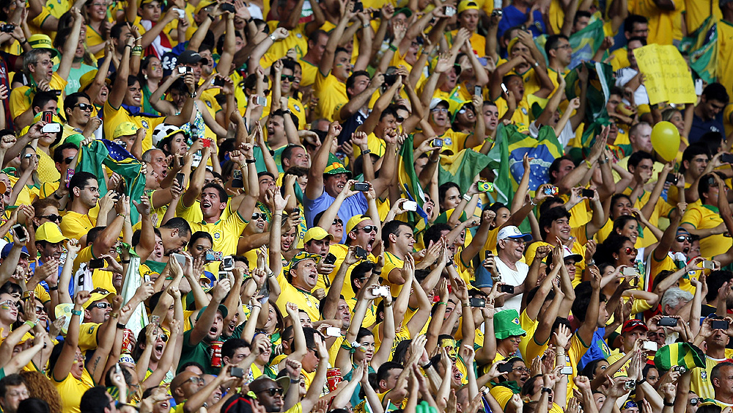
The Passion

Slide 8
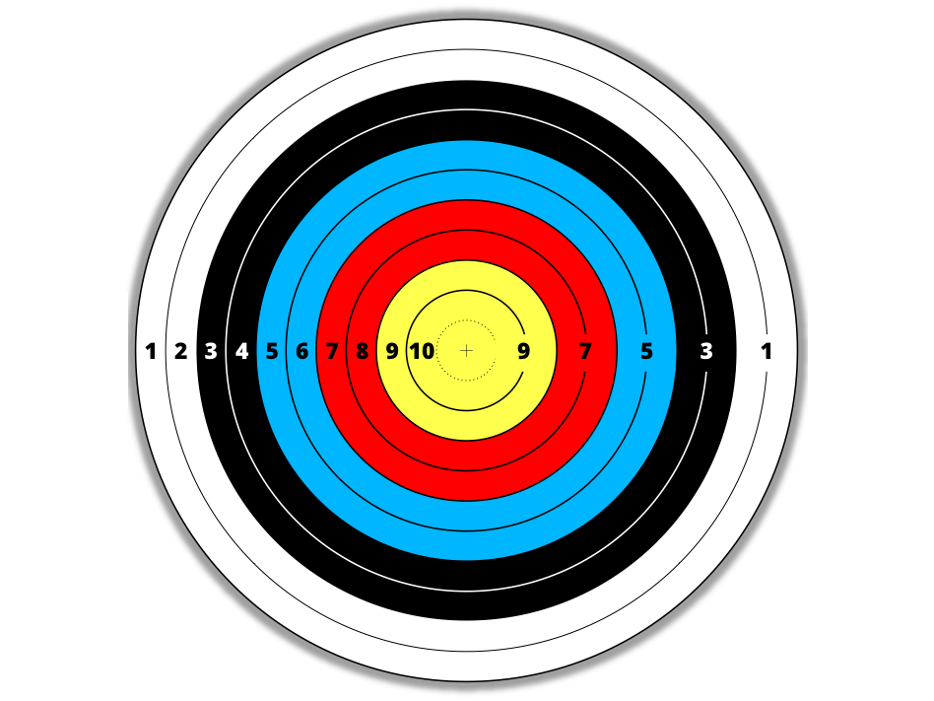

Do you know what you are missing?
Know how to act?
Have the relevant info?
Don’t miss the target
Notes:
One Shoot

Slide 9
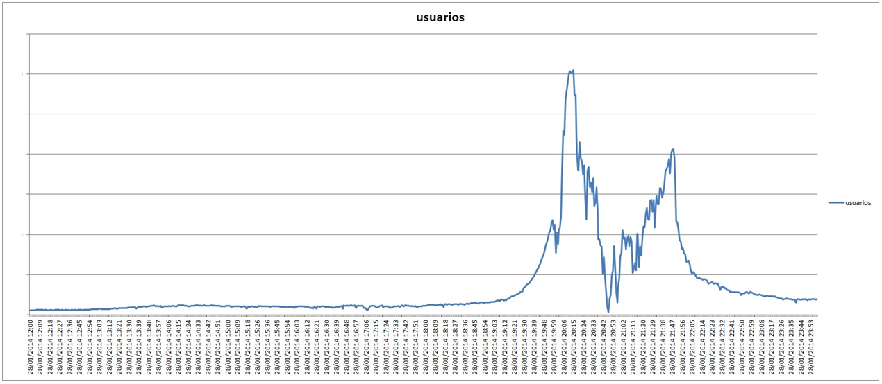
The Behaviour
Notes:
Users log 5 minutes before the match. We need to scale and stability fast!
This is the behaviour we had before starting the improvement. We saw users having problems when logging.

Slide 10
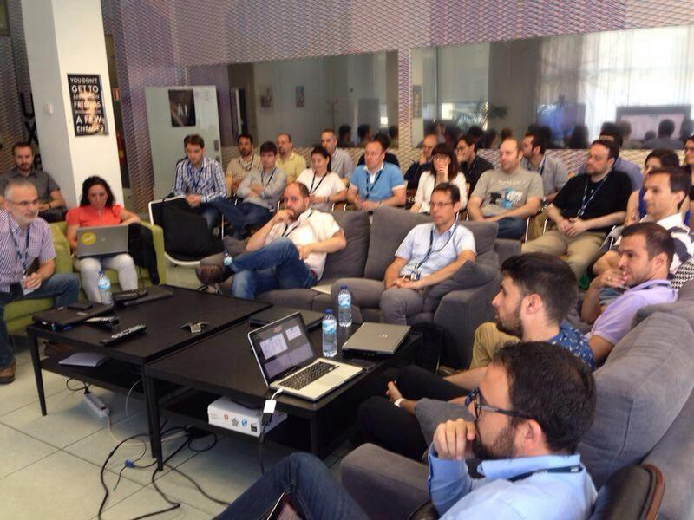
The Team
Notes:
The team:
Developers, service delivery, Operations, QA
distributed in different scrum groups dedicated to a service
Content WorkFlow
Devices
IPTV
Platform
CDN
Suggestions
BI

Slide 11
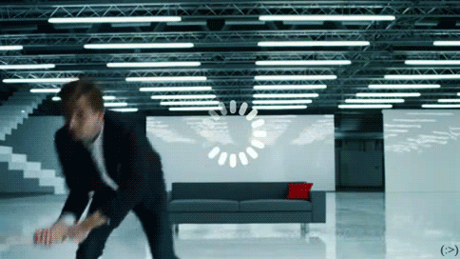
Our Goal
Notes:
To achieve the best experience for the users. Make of Telefonica a Video Company.
The end of Buffering
the best Experience for our Users. Live television available from any mobile device ( android, windows phone, iOS ) SmartTVs … set top boxes
Whenever. Wherever, however

Slide 12
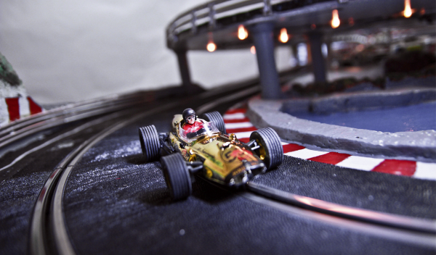
Scalability
Notes:
Smart Probes in front ends ( predictive and scheduled growth ) for instance during an important match as Barça Madrid ( 2013 )
Modular Enabling ( Being able to switch on and off some services such as encoding or content ingestion when the resources are needed in another service )
Cache optimization
MongoDB session handling optimization
DataBase optimization
API optimization

Slide 13
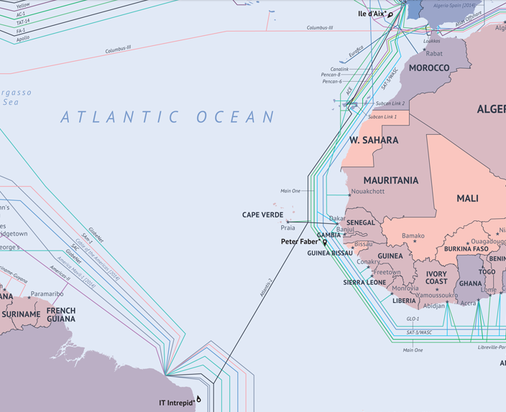
Spain - Brazil- Argentina
Notes:
Infrastructure Challenge
Latency and migration of datacenters

Slide 14

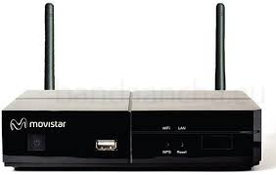
And MANY more ….
Many Devices
Notes:
Challenge all the platforms available not only mobile and PC but also, consoles, STB and Smart TV’s

Slide 15
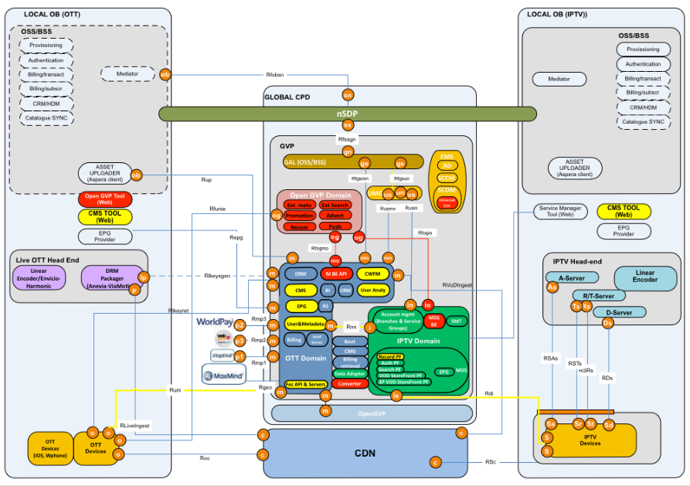
The Jungle
Notes:
Complexity of the Platform due to integrated services with 3rd parties ( Mediaroom, Widevine, Elemental, PlayReady Isssuer … ) and the integration with the Local Business Centres ( OB’s )

Slide 16
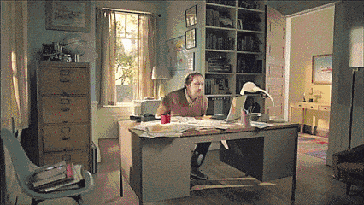
Change of Strategy

Slide 17
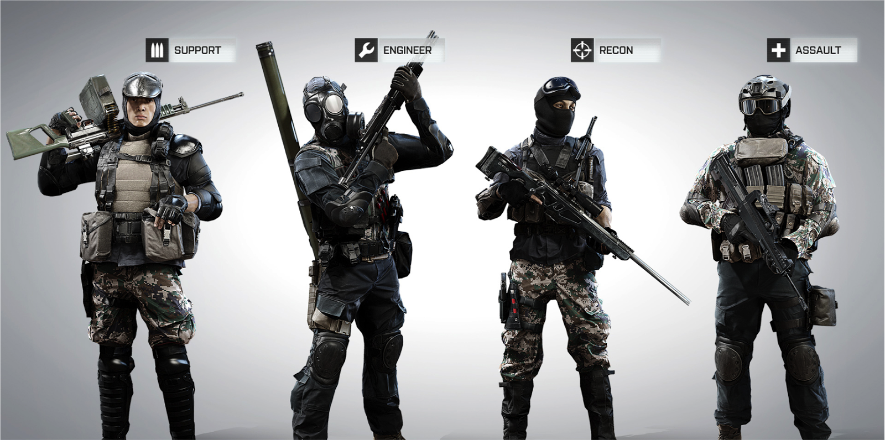
Global Video Platform Squads
Notes:
While maintaining the usual dev/qa squads working in sprints ( SCRUM ), some other specialized squads were created involving ops, service delivery, performance and devs. Frontal Engineering, Security and Performance for instance were squads created as a “task force” parallel to the daily work of the usual scrum squads.
We define SQUADs per feature, related group of features or task force, involving people from different disciplines (TPM, PGM, DEV, QA, etc.)
So SQUADs:
Have a clear mission and backlog
Self organized and autonomous. Dailys happen inside SQUAD
From 5 to 10 people involved (dynamic)
Each person should not be involved in more than 3 SQUADs
Shared knowledge about a feature and Domain expertise
Squad Leader will maintain SQUAD and track cross-dependencies. Anyone can lead a SQUAD, just ask for it
There will be TRIBE meetings, where we will track dependencies and follow backlogs evolution

Slide 18
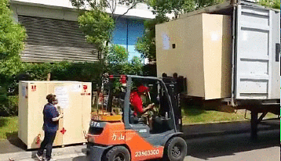
PREPROD Environment
Automated Tests in .NET
Stable Environment
Continuous ... wait ... what?
Notes:
Continuous Integration QA effort for automation of every device, 80% coverage
Using same tools as Devs ( visual Studio ) improved the quality and coverage of tests.
Migrating from Jmeter to Visual Studio Load Testing tools.
A stable testing in production environment
Continuous Delivery: delivering new content and new modular features.

Slide 19

WHO Ops Networking, Performance and Security Eng.
WHAT Avalanche Control
Concurrent Session Control
HOW Firewall Policies, Smart Probes, MongoDB
Front End Engineering
Notes:
All servers got all sofrware

Slide 20
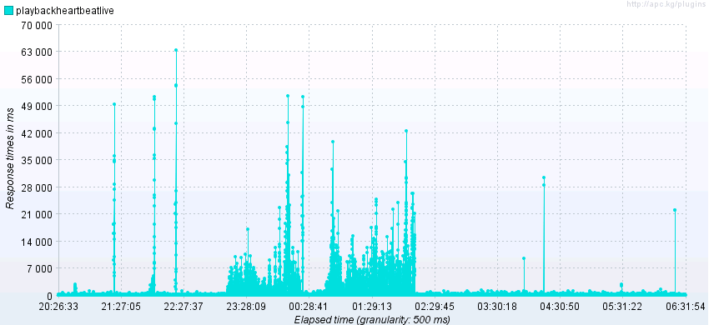
MongoDB Issues
Notes:
All servers got all sofrware

Slide 21
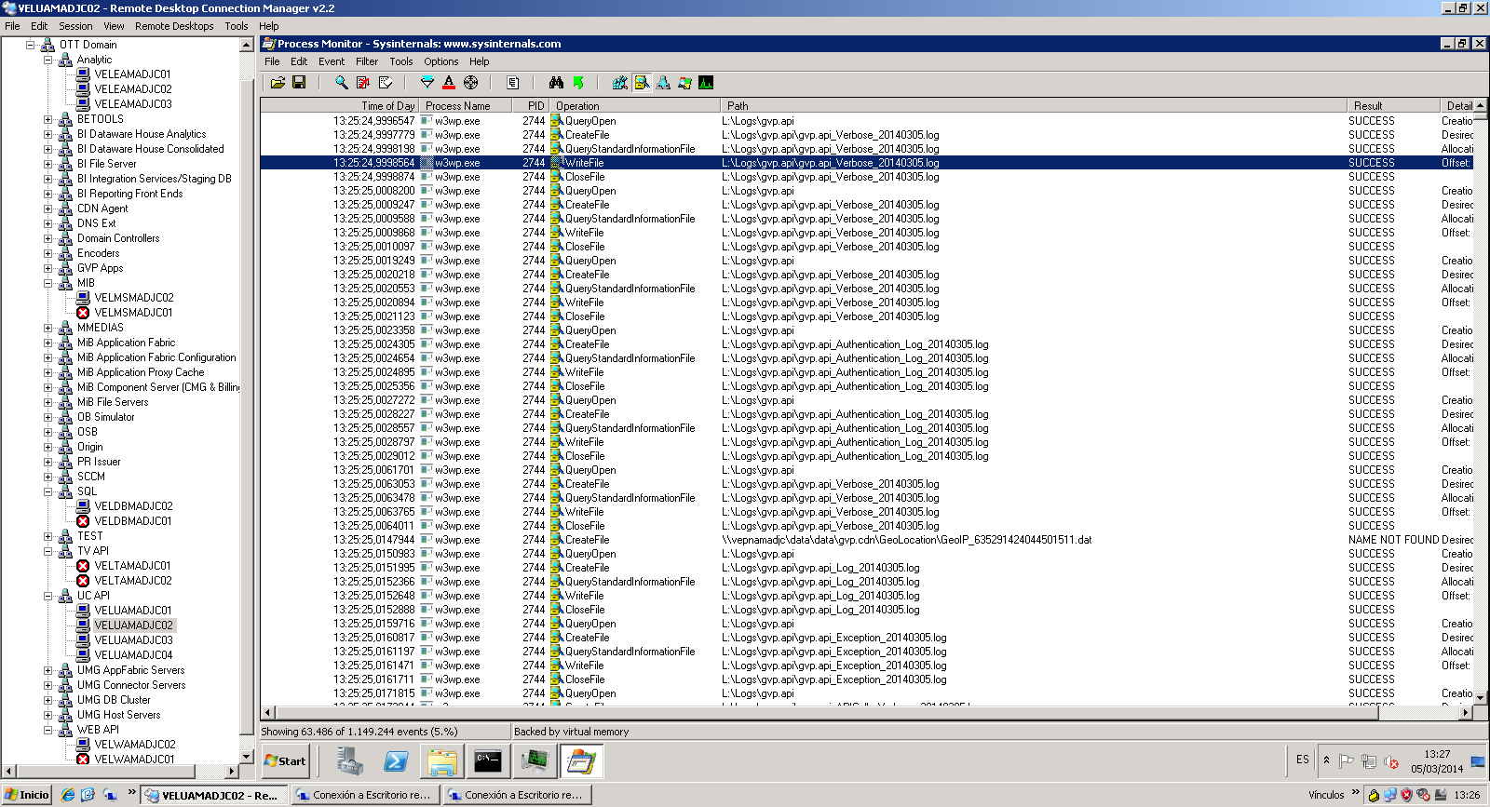
NAS issues
Notes:
All servers got all sofrware

Slide 22

Cache, DB Tuning
Scalability, Resilience
Load Analysis and Simulation
Performance
Notes:
Developers, Service Delivery and Performance Testers, Ops

Slide 23
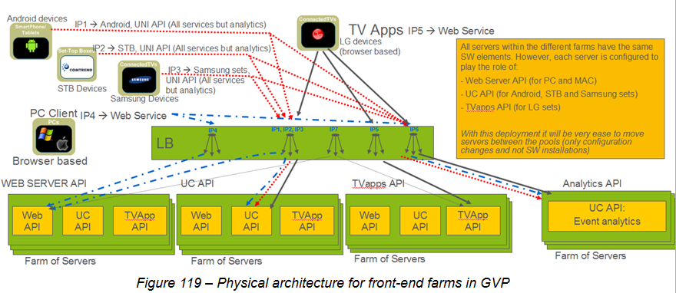
Deployment
Notes:
All servers got all sofrware

Slide 24
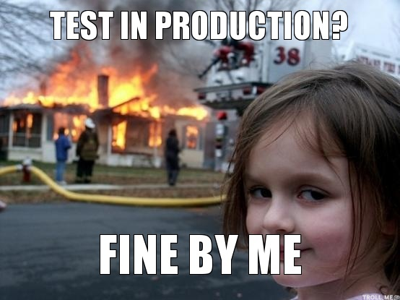
Stable Testing Environment
Notes:
but we still have the problem that pre production environment was not accurate … we wanted to be really sure so we enable a testing environment in production. learning process, first time we did a test it killed the Database :D From then on we refined the testing environment and the testing suite.

Slide 25
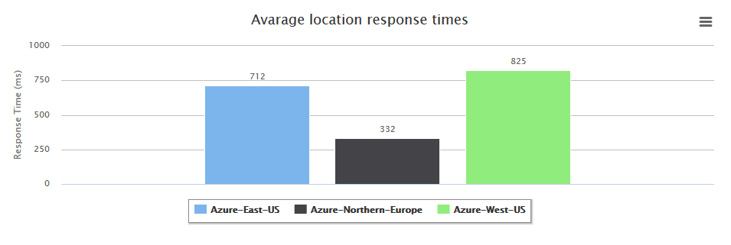
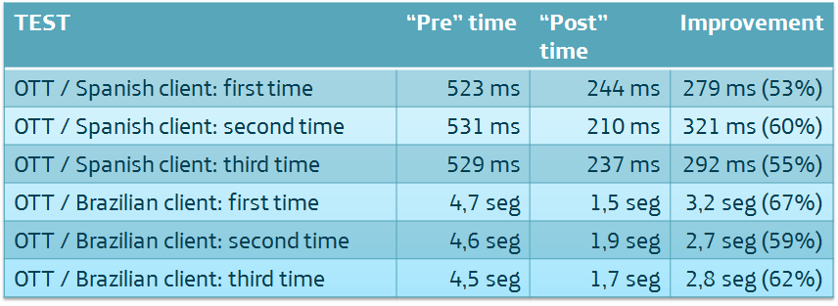
Latency

Slide 26

In House CDN
Notes:
http://test.cdn.telefonica.com/?page_id=7

Slide 27
Graphite
Audience
Storage (SAN/NAS)
Web Servers (FE/API)
Cache Layer
Databases
Networking
Virtualization
Don’t miss the target
Notes:
One Shoot

Slide 28
Old Approach
New Approach
Monitoring resolution 5 minutes
11 tools to monitor performance
Monitoring resolution 15 seconds
Centralized in 1 tool to monitor performance
Don’t miss the target
Notes:
Soccer is one Shoot – 9 times to check and adjust vs 180 times

Slide 29
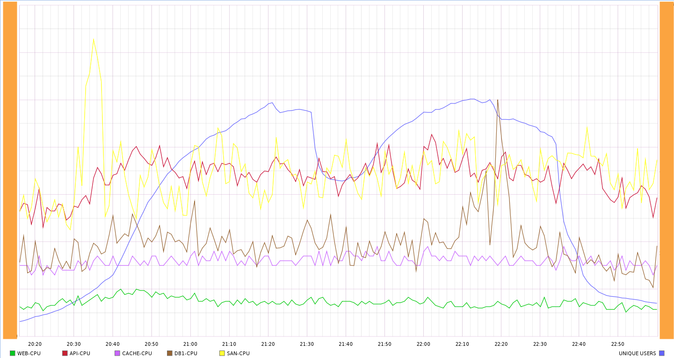
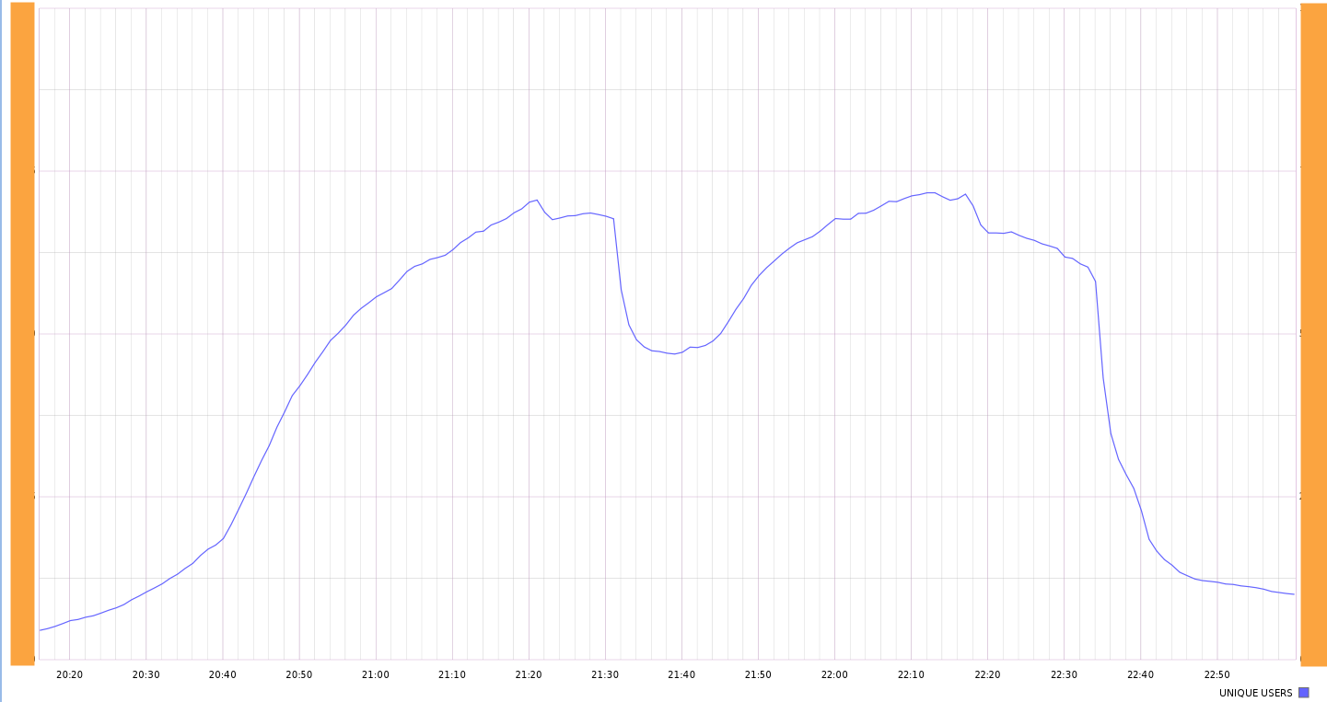
2nd half begins
Introducing: The Soccer Game
1st half ends
2nd half ends
match begins
Don’t miss the target
Notes:
One Shoot

Slide 30
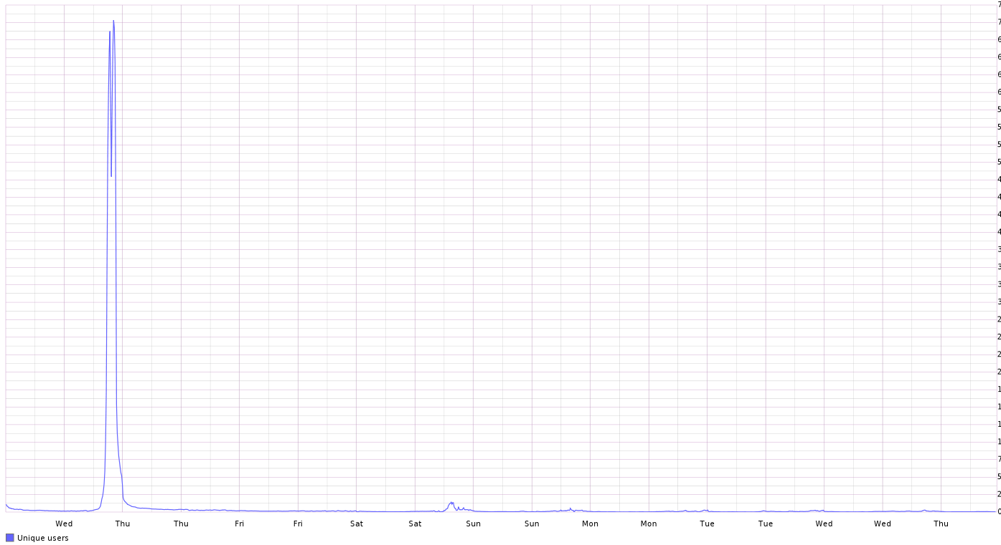

BE PREPARED FOR THE PEAK
Simulate your workload and know your bottleneck
Don’t miss the target

Slide 31
It is better know the bad things when you have time to solve it !!!!
Don’t miss the target

Slide 32
Don’t do queries with full tables scans
Show and give access
SELECT
OBJECT_NAME(S.[OBJECT_ID]) AS [OBJECT NAME],
I.[NAME] AS [INDEX NAME],
USER_SEEKS,
USER_SCANS,
USER_LOOKUPS,
USER_UPDATES
FROM
SYS.DM_DB_INDEX_USAGE_STATS AS S
INNER JOIN SYS.INDEXES AS I
ON I.[OBJECT_ID] = S.[OBJECT_ID]
AND I.INDEX_ID = S.INDEX_ID
Don’t miss the target

Slide 33
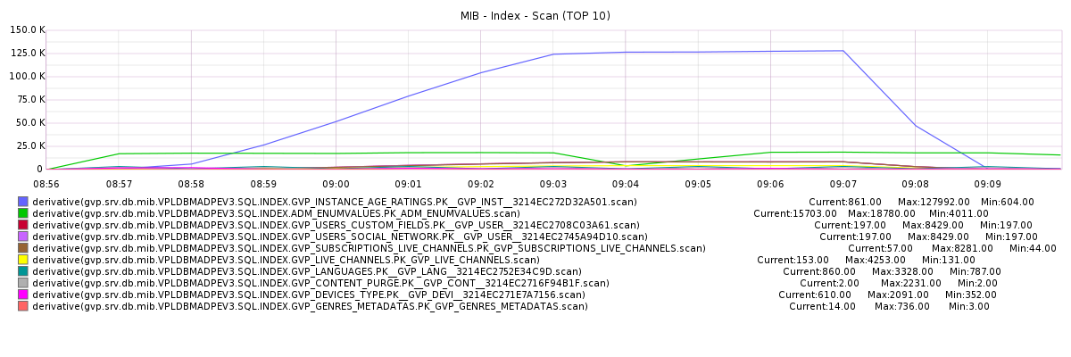
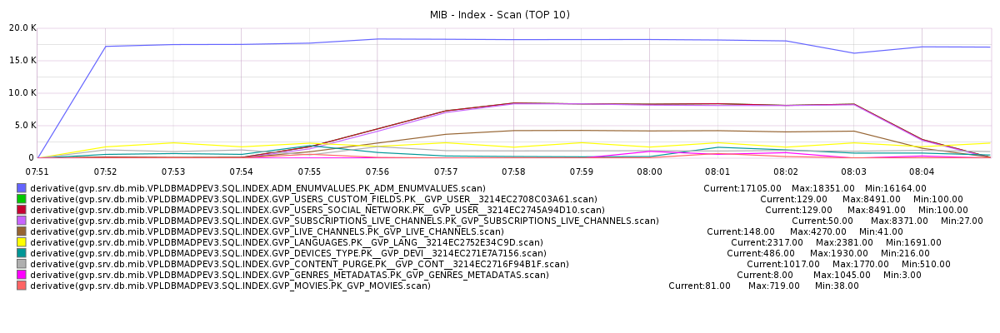
1 Index Creation
1 Query change
Don’t miss the target

Slide 34
The soccer game will start
if you are ready or not.
Get your team ready. They have to know what to do.
It will start without you

Slide 35
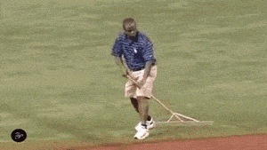
It will start without you

Slide 36

Questions
?

Slide 37

Thank you!!!

